Slide 1
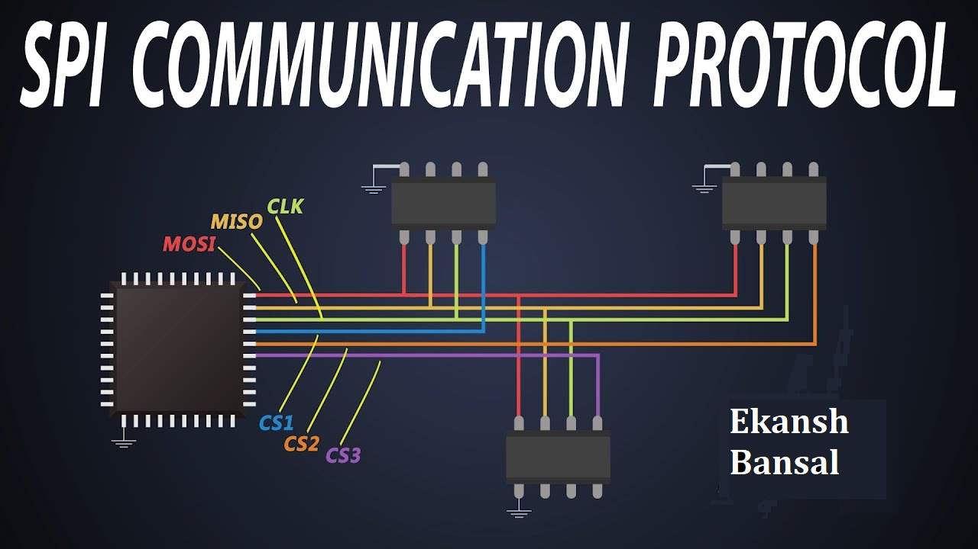

Slide 2
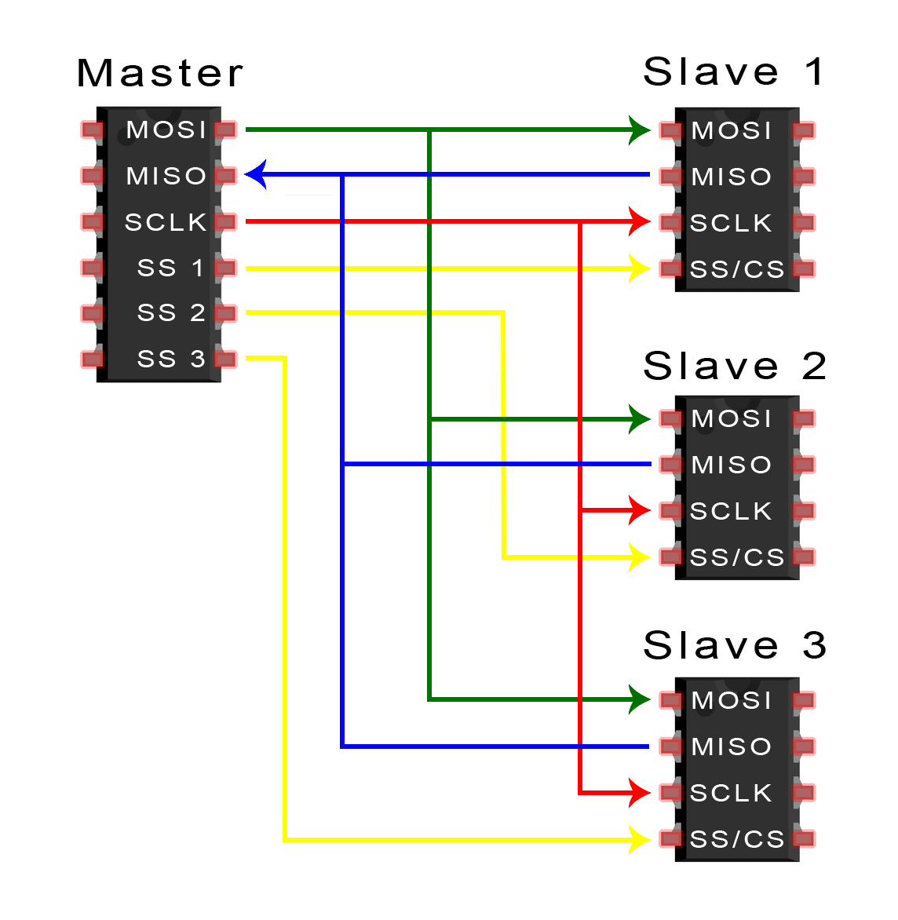
Introduction
Serial Peripheral Interface (SPI) is a synchronous serial communication interface used for short-distance communication between microcontrollers, sensors, and other devices.
SPI is a full-duplex interface, meaning that data can be transmitted and received simultaneously.
SPI is widely used in embedded systems due to its simplicity, low cost, and high-speed data transfer capabilities.
1

Slide 3
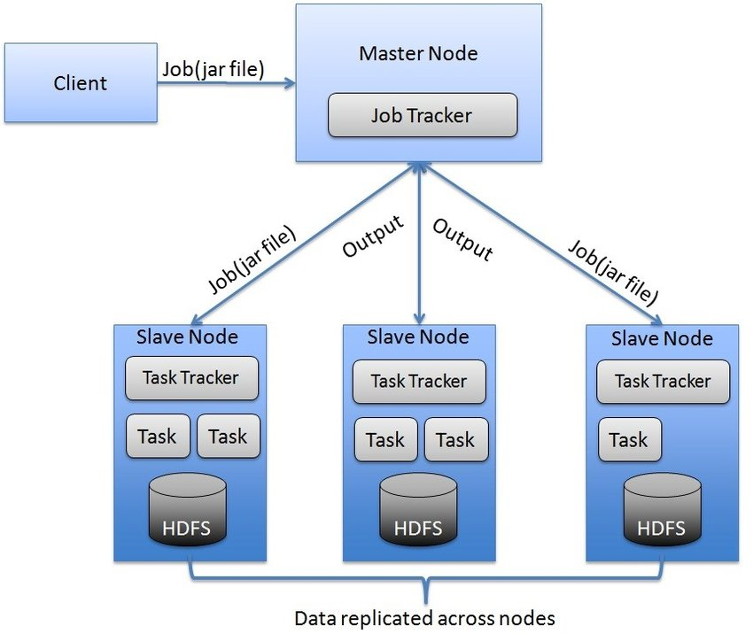
Basic Communication
SPI uses a master-slave architecture. The master device initiates the communication and controls the clock signal, while the slave devices receive and send data.
Data is transferred in frames, which consist of a clock signal and a data signal.
The clock signal is generated by the master device and is used to synchronize the transmission of data.
2

Slide 4
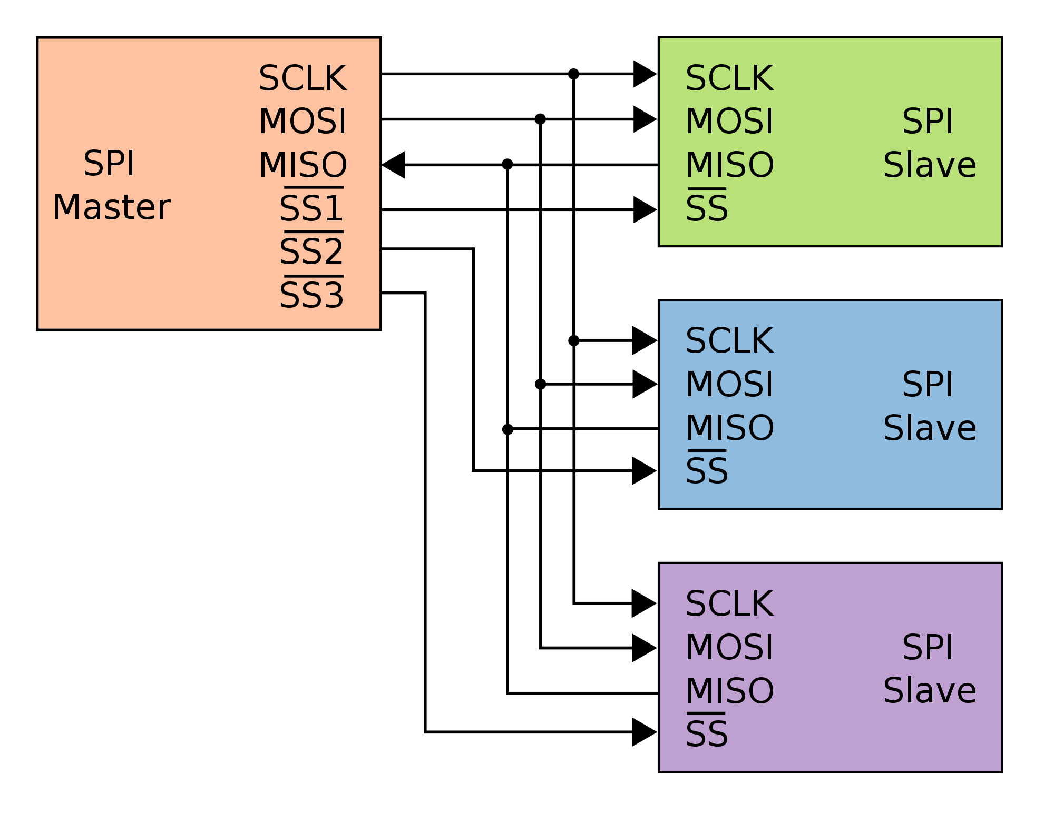
Pin Configuration
SPI requires a minimum of four pins: MOSI (Master Out Slave In), MISO (Master In Slave Out), SCK (Serial Clock), and SS (Slave Select).
MOSI is used to transmit data from the master to the slave, while MISO is used to transmit data from the slave to the master.
SCK is the clock signal generated by the master, and SS is used to select the slave device that will communicate with the master.
3

Slide 5
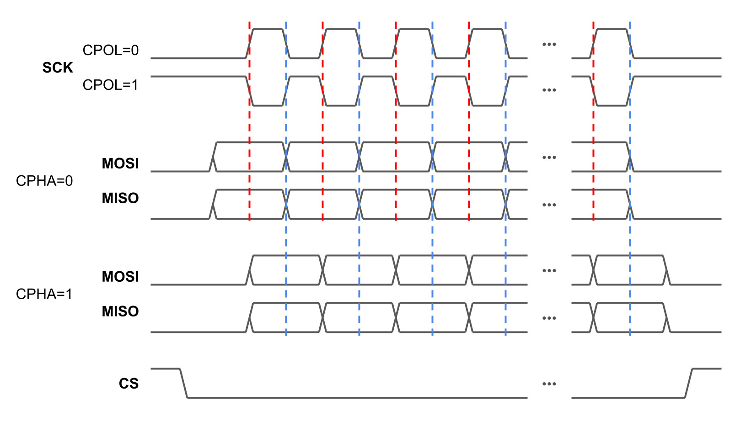
Data Transfer Modes
SPI supports four data transfer modes, which are determined by the polarity and phase of the clock signal.
Mode 0: Clock is idle low, data is sampled on the leading edge and changes on the trailing edge.
Mode 1: Clock is idle low, data is sampled on the trailing edge and changes on the leading edge.
4

Slide 6
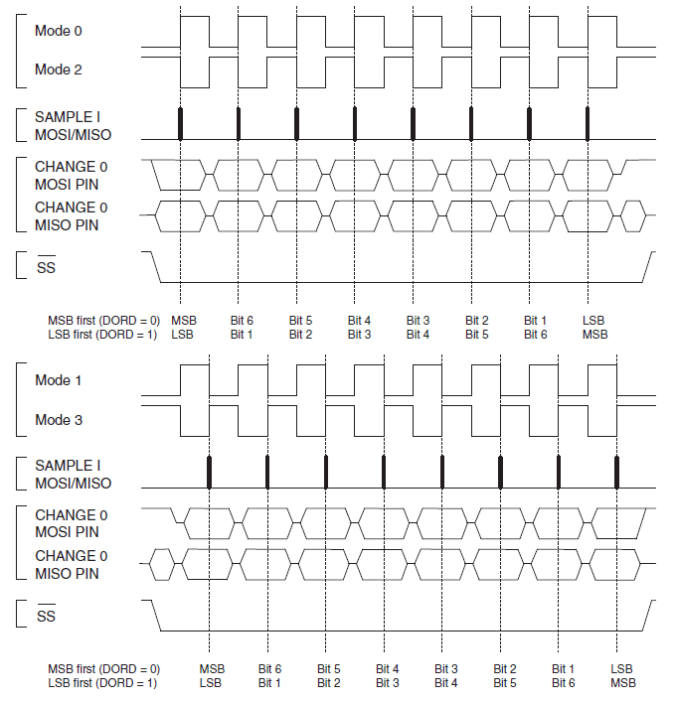
Data Transfer Speed
SPI supports high-speed data transfer rates, with speeds ranging from a few kilobits per second to tens of megabits per second.
The data transfer speed is determined by the clock frequency and the number of data bits per frame.
SPI can also support lower data transfer speeds by using slower clock frequencies or by dividing the clock signal.
5

Slide 7
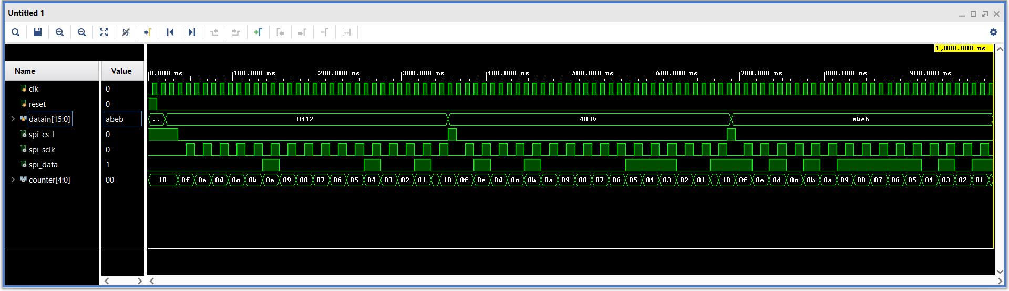
Results: Output Waveform
6

Slide 8
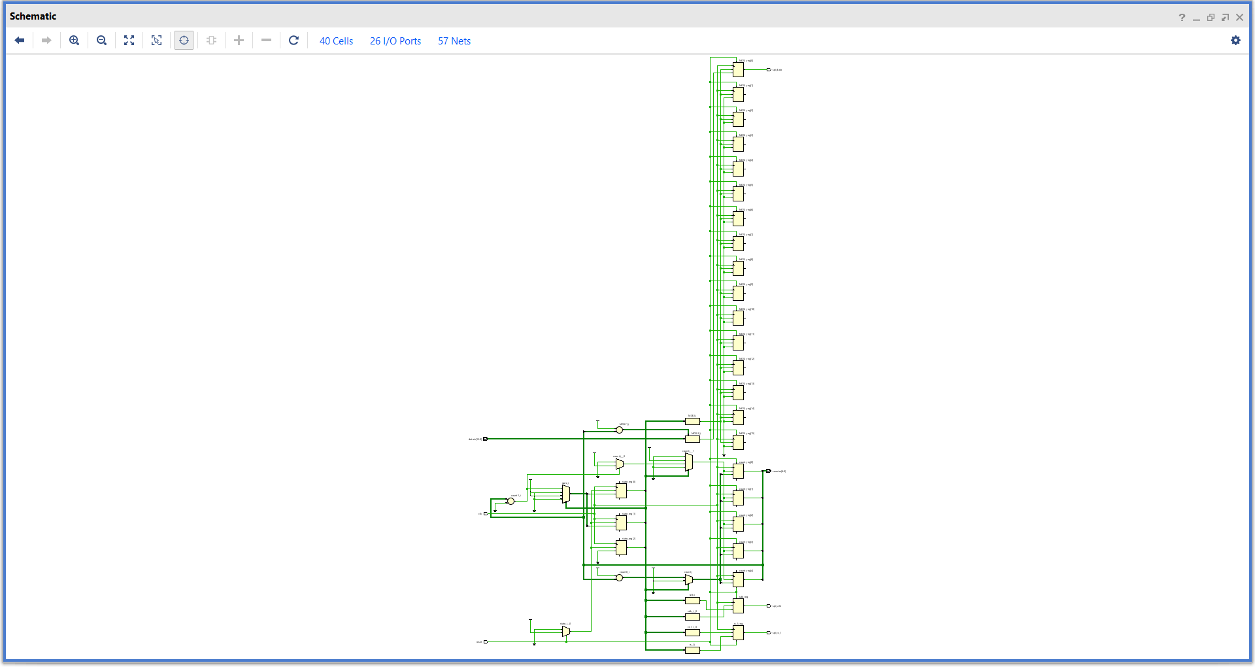
Results: RTL
7

Slide 9
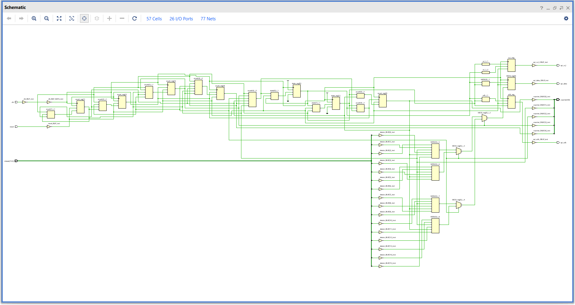
Results: Synthesized Design
8

Slide 10
Advantages of SPI
SPI is straightforward and convenient to utilize, requiring only a few essential pins.
Full-duplex communication is facilitated by SPI, enabling simultaneous transmission and reception of data.
SPI possesses rapid data transfer capabilities, allowing for high-speed communication.
Multiple slave devices can be supported by SPI, accommodating the connection of several peripherals.
Implementing SPI is uncomplicated and does not involve complex configurations.
9

Slide 11
Disadvantages of SPI
The primary function of SPI is to facilitate communication over short distances, typically on a PCB or between closely located devices.
Each slave device in an SPI setup necessitates a distinct SS pin, which imposes a restriction on the number of devices that can be interconnected.
SPI is designed for short-range communication within close proximity, such as on a circuit board or between nearby devices.
Advanced features like error detection and flow regulation are not part of SPI's capabilities.
The number of connected devices in an SPI configuration is constrained by the requirement of a separate SS pin for each slave device.
10

Slide 12
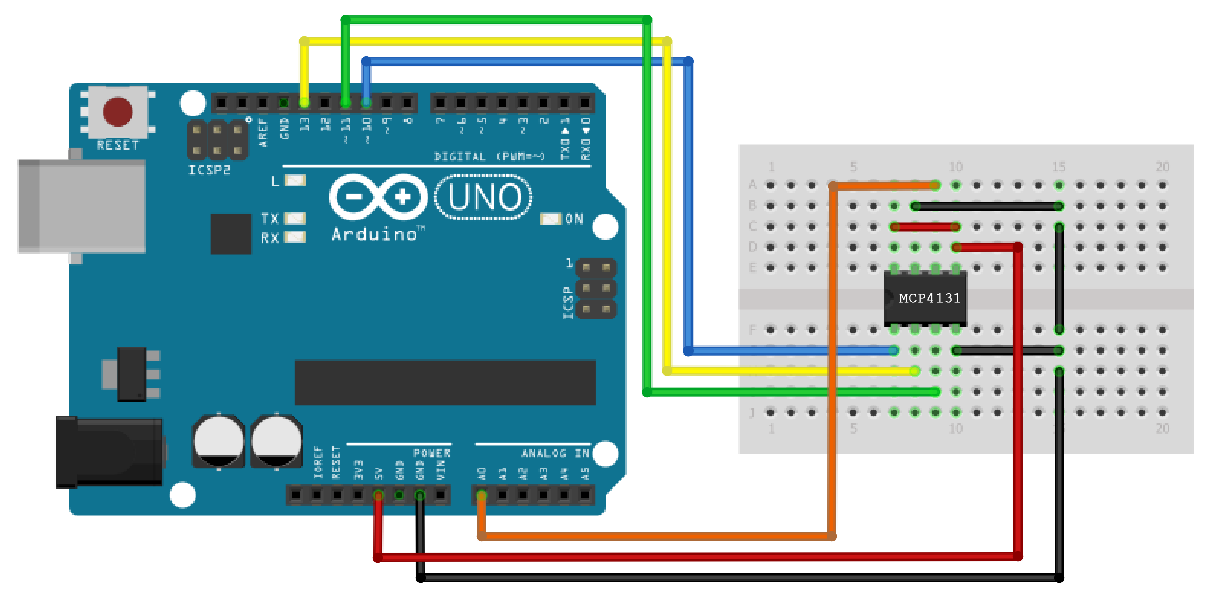
Applications of SPI
SPI is commonly used in embedded systems for communication between microcontrollers and sensors, such as accelerometers, gyroscopes, and temperature sensors.
SPI is used in flash memory, EEPROM, and other non-volatile memory devices for data storage and retrieval.
SPI is used in communication between peripheral devices and microcontrollers, such as LCD displays, ADCs, and DACs.
11

Slide 13
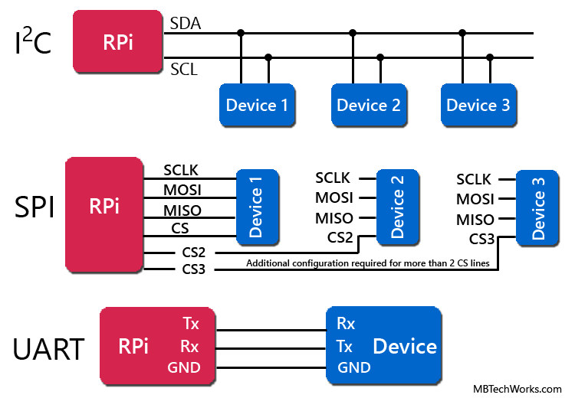
Comparison with Other Interfaces
SPI is similar to I2C and UART interfaces, but has different advantages and disadvantages.
I2C supports short-distance communication and can connect multiple devices on the same bus, but has lower data transfer rates and requires more complex software.
UART is simple and easy to implement, but only supports half-duplex communication and has lower data transfer rates.
12

Slide 14
Conclusion
Due to its simplicity, affordability, and ability to transfer data at high speeds, the Serial Peripheral Interface (SPI) is extensively employed as a communication interface in embedded systems.
SPI enables full-duplex communication, facilitates short-range data exchange, and can accommodate multiple slave devices simultaneously.
When compared to alternative interfaces, SPI possesses both advantages and disadvantages, making its suitability for a given application contingent on specific requirements.
The choice to utilize SPI in embedded systems hinges on factors such as the desired level of simplicity, cost-effectiveness, and the need for high-speed data transfer.
13

Slide 15


